Slide 1
Automatic Ticket Classification - Using NLP
By Madhu Nuthula
On 20/01/2023

Slide 2
BIO
8 years+ experience in the Information & Technology industry, with an in-depth and comprehensive knowledge on Networking, Server administration & ICT Support
Qualifications:
Graduate Certificate in Data Science/AI
National Diploma in Business
Diploma in Multimedia, Internet and Web Design
Certificate in Advanced Computing

Slide 3

Problem Statement
Cluster the complaints in to 5 categories.
Create a model that can classify the tickets automatically which will help route the complaint to appropriate department and resolve it faster.

Slide 4
Importance
Complaints are vital part of the business to be addressed in timely manner.
Most customers do not complain
It is an opportunity for a business
Customer is already disappointed and needs to be addressed sooner before it is too late.
For Financial Institutions, a late response can lead to major financial loss
It is important to have an effective complaints handling system in place for any business.
If the complaint is allocated to the right department, then there is high chance to solve the complaint immediately. Thus we can
Prevent a dissatisfied customer from churning
Build a positive brand reputation
Avoid monetary loss in compensations
No Customer = No Business

Slide 5
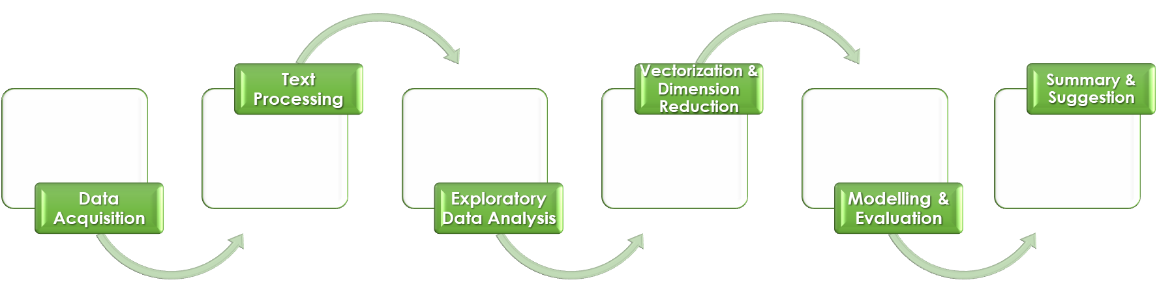
Project Process

Slide 6
Dataset
The Dataset is sourced from Kaggle, which contains the complaints record of a financial institution from The Consumer Financial Protection Bureau (CFPB) a federal U.S. agency that acts as a mediator when disputes arise between financial institutions and consumers. Via a web form, consumers can send the agency a narrative of their dispute.
Extracted required information from the JSON file
Initial extracted dataset was in shape(78313 rows, 5 columns)
Columns:
Complaints - Actual complaint text
Product - Complaint Category chosen by customer
Sub_product - Complaint sub-category chosen by customer
Issue - Issue about the complaint written by customer
Sub_issue - Sub issue about the complaint written by customer
Source: https://www.kaggle.com/datasets/abhishek14398/automatic-ticket-classification-dataset

Slide 7
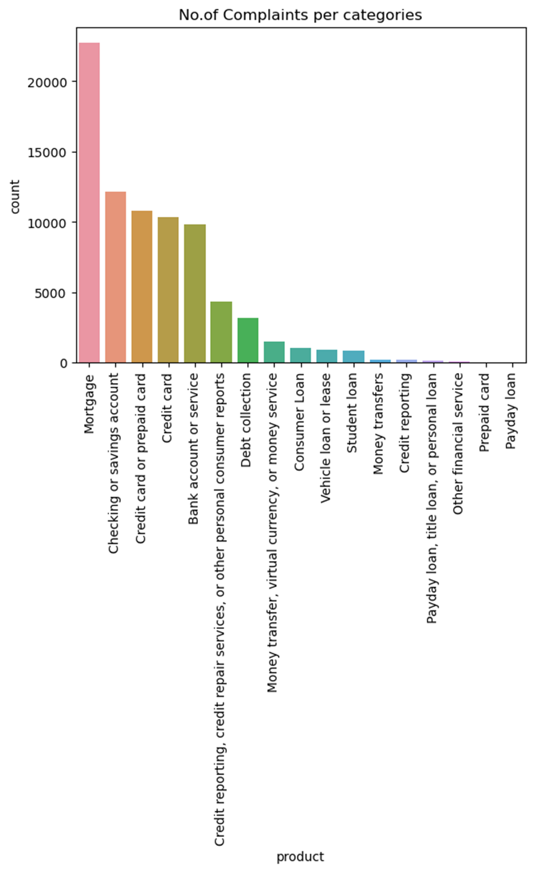
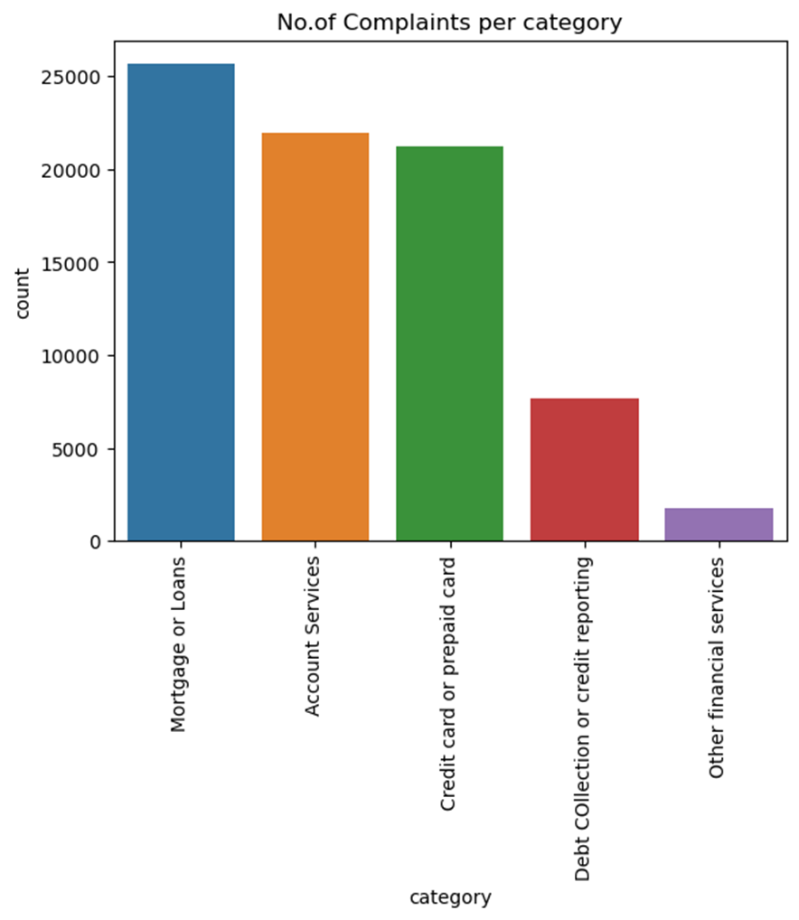
EDA
Before Clustering
17 categories
After Clustering
5 categories

Slide 8
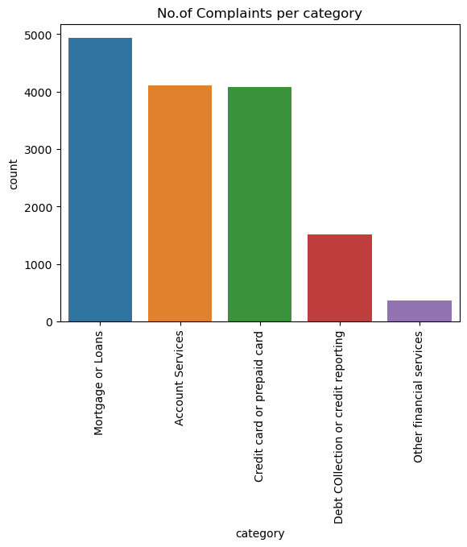
EDA
33%
27%
27%
Reduced data set to 15,000 rows to match the Computing resources available.
To the right are the visuals of categories after clustering to 5 categories
10%
2%

Slide 9
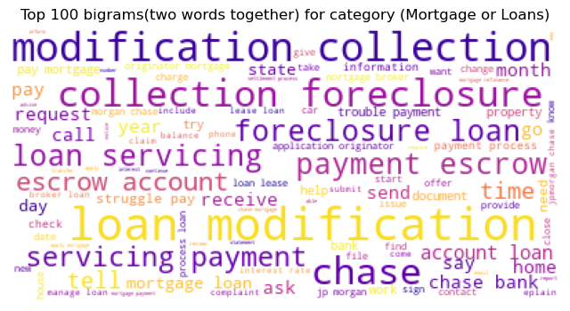
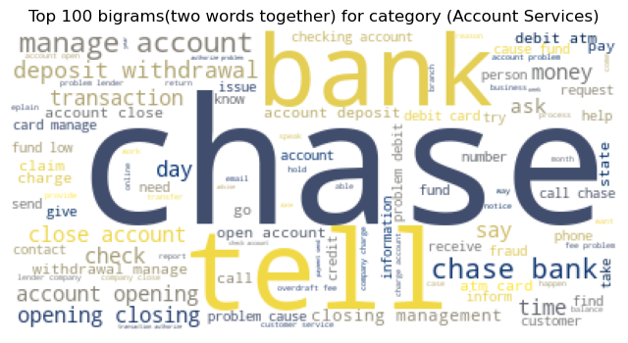
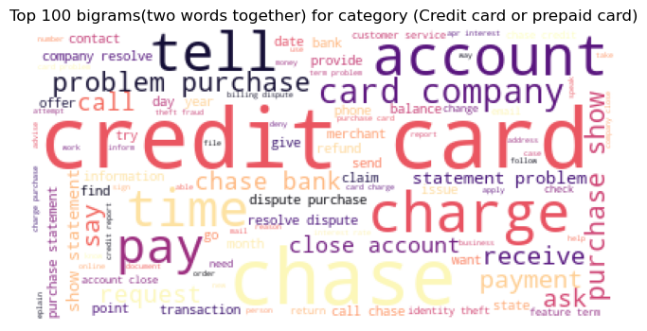
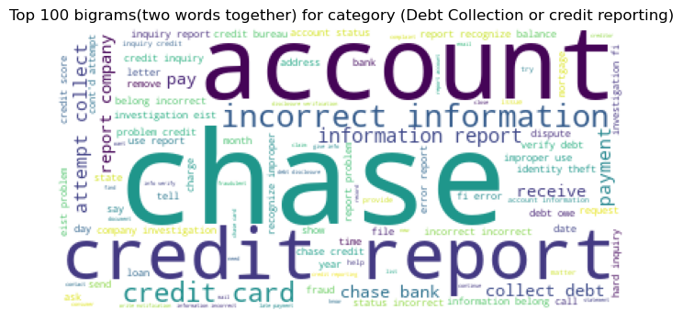
Word Cloud Visuals

Slide 10
Model Evaluation - Results
Model | Results (Accuracy)
Logistic Regression | 0.89
Support Vector Classifier | 0.86
Decision Tree Classifier | 0.82
AdaBoost Classifier | 0.81
Gradient Boosting Classifier | 0.83
Random Forest Classifier | 0.85
Model (Hyper Parameter Tuned) | Results (Accuracy)
Logistic Regression | 90%
Random Forest | 86%
Best Model
Logistic Regression with Accuracy of 90%

Slide 11
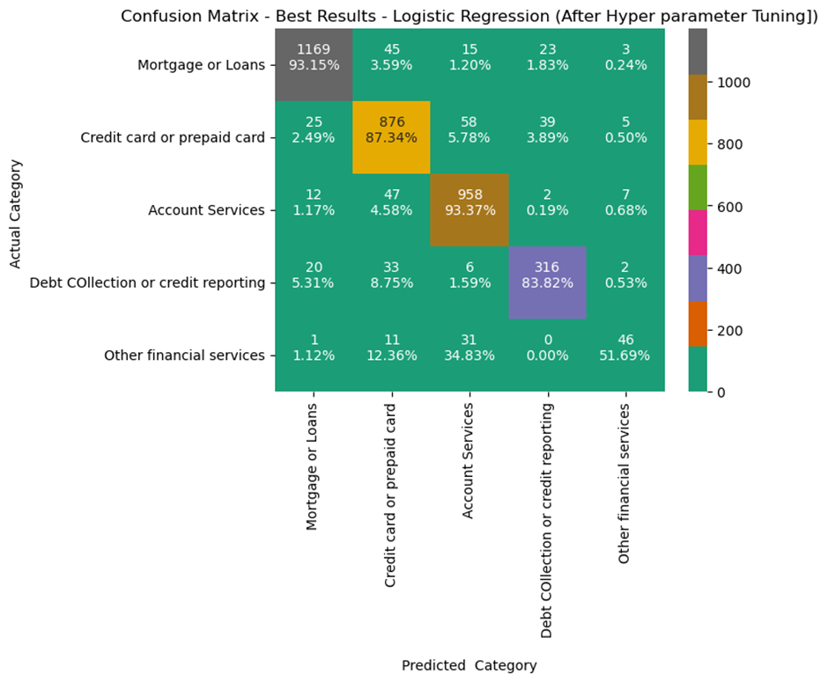
Confusion Matrix
Best Model - Logistic Regression
Accuracy - 90%
Category “Other Financial Services” has 51% accuracy; due to the less no.of complaints in it. Can be improved by acquiring more data in for that category.

Slide 12
Summary
With the help of proposed model now we can categorize the complaints with 90% accuracy and this can be routed through the appropriate departments.
Financial Institutions can benefit:
Faster complaint resolution
Improved customer satisfaction
Prevent financial loss
Identify areas to improve
Win the competitors and lead the Market.
Suggestion
Adequate computing resources for advanced modelling to gain better results
Can be implemented in to any business sector
Unsupervised learning using Topic modelling
Customer Satisfaction = Business Growth
If you value your Business, you must value your CUSTOMERS

Slide 13
References
Automatic Ticket Classification Dataset | Kaggle
consumer-finance-complaints · Datasets at Hugging Face
https://www.kaggle.com/code/vikram92/multiclass-complaints-classification-using-bi-lstm
https://www2.deloitte.com/content/dam/Deloitte/us/Documents/regulatory/us-aers-the-power-of-complaints-042115.pdf
https://www.zendesk.com/blog/customer-complaints-10-tips-manage-better/
https://www.consumerfinance.gov/

Slide 14
Questions and Answer Session
Firstly, Thank you all for the time!
Any Question?
End of Presentation!

